Slide 1


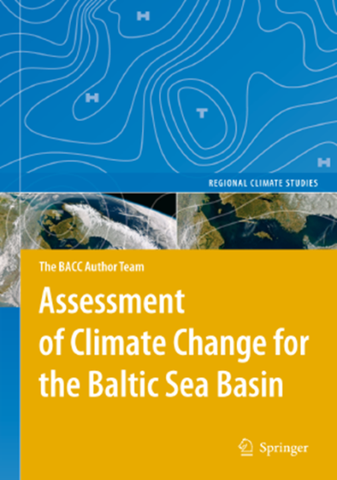
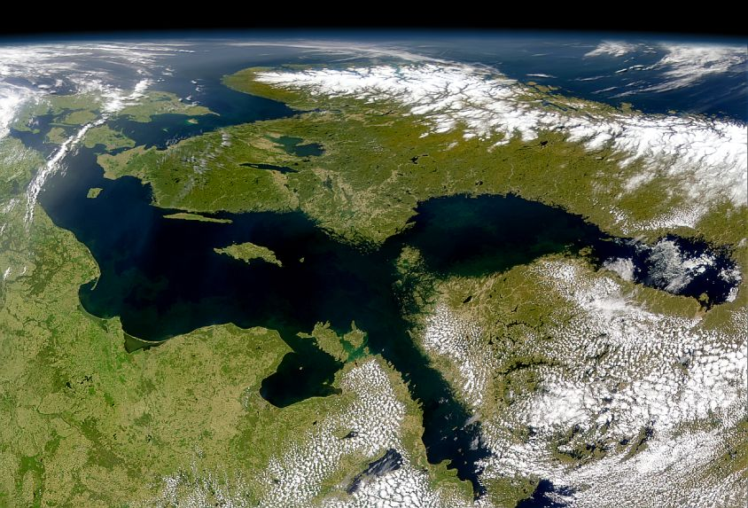
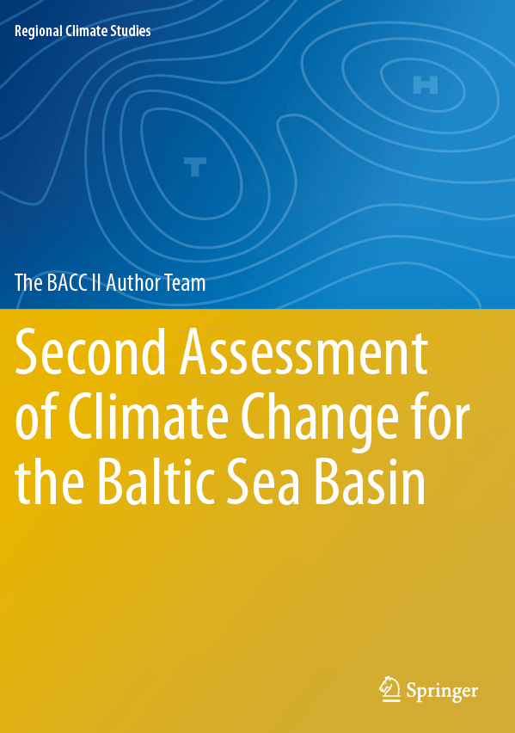
Baltic Earth
Earth System Science and Outreach
for the Baltic Sea Region
Marcus Reckermann
Hans-Jörg Isemer and Silke Köppen
International Baltic Earth Secretariat
Helmholtz-Zentrum Geesthacht, Germany
Markus Meier, Anna Rutgersson
and the Baltic Earth Science Steering Group members

Slide 2
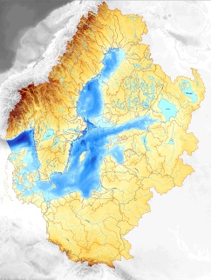
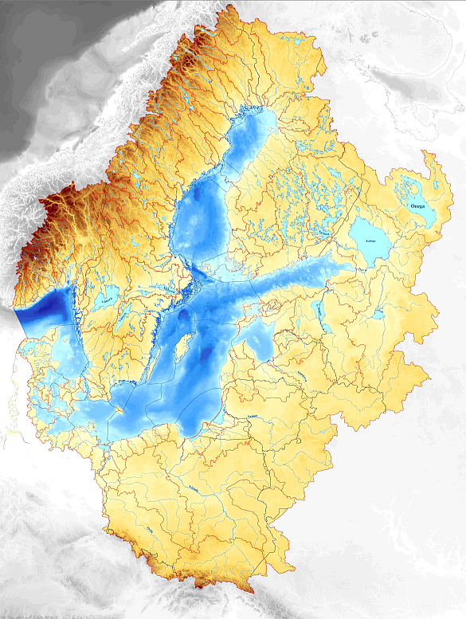
The Baltic Sea region
Drainage Basin: 2.13 Mill. km²
(20% of the European continent)
85 million people in 14 countries
Baltic Sea: 380 000 km²
St. Petersburg:
Northernmost city with > 1 million

Slide 3
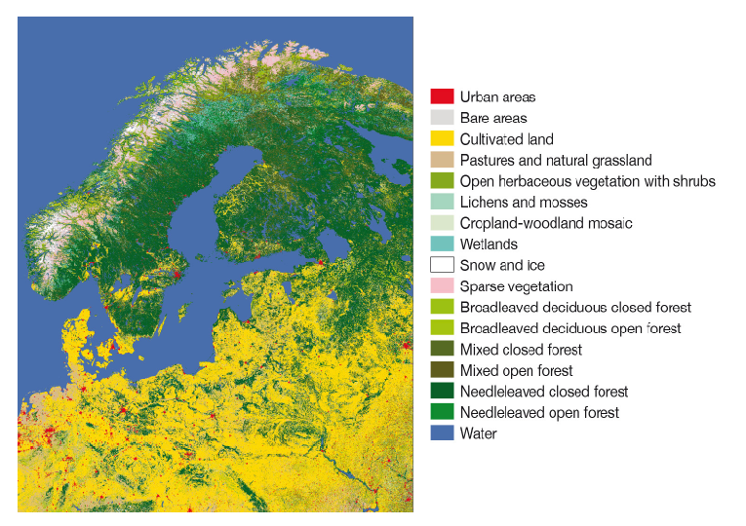
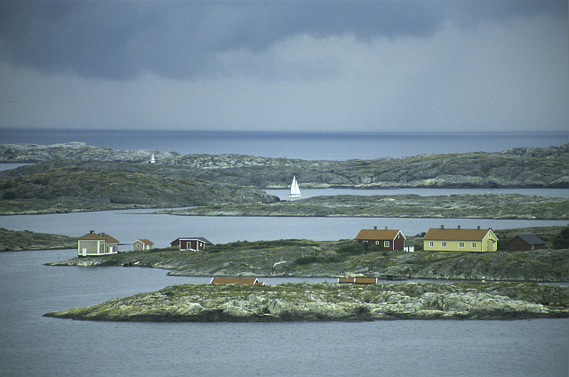
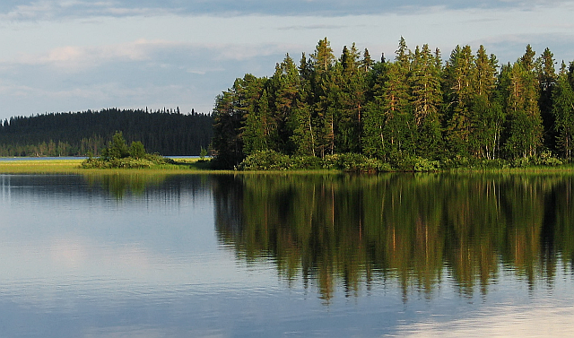
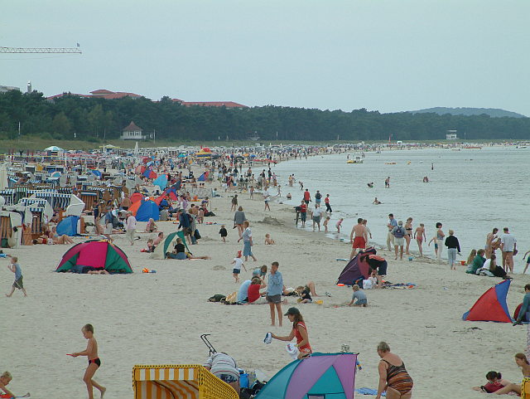
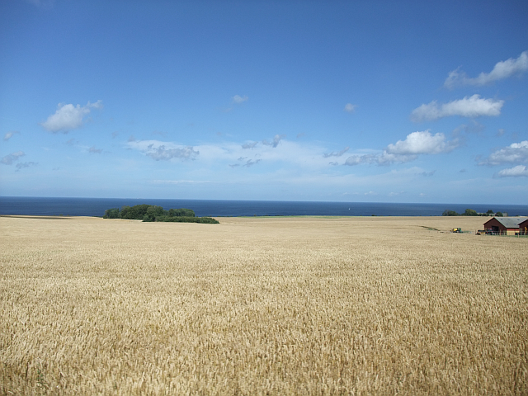
The Baltic Sea region
The North …
  extensive forests, mostly coniferous
  sparsely populated
  mostly rocky coasts
  subarctic climate in winter
  The South…
  intense agriculture
  densely populated
  mostly sandy coasts
  moderate climate in winter

Slide 4

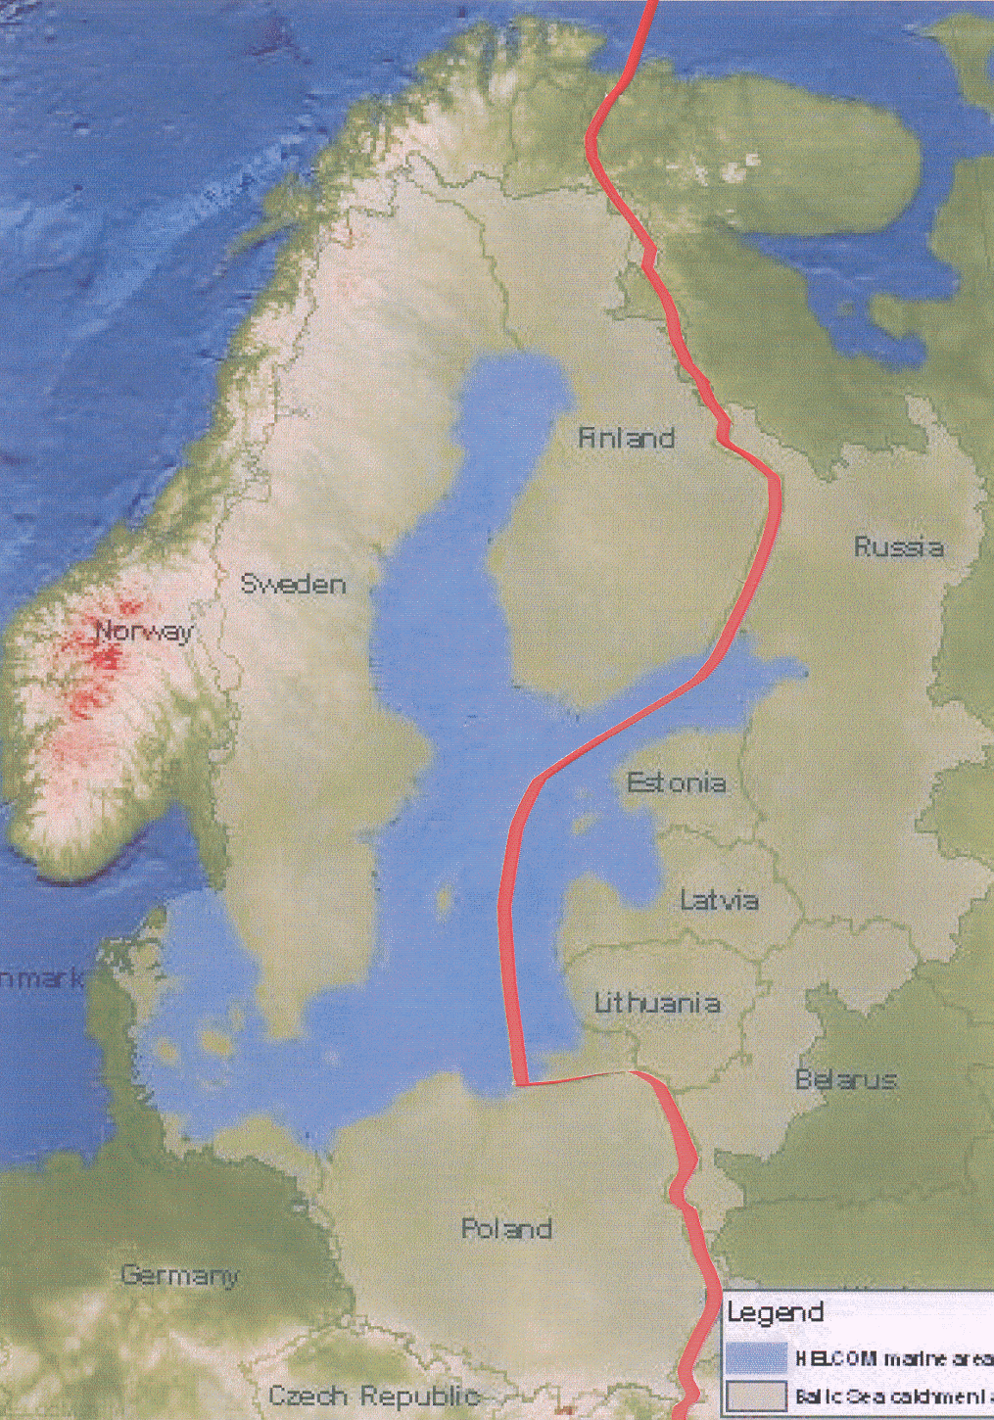
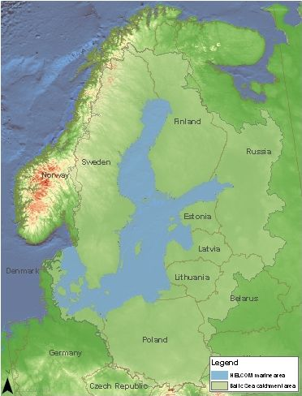

Motivation for an international interdisciplinary research network
1991
www.baltic.earth

Slide 5



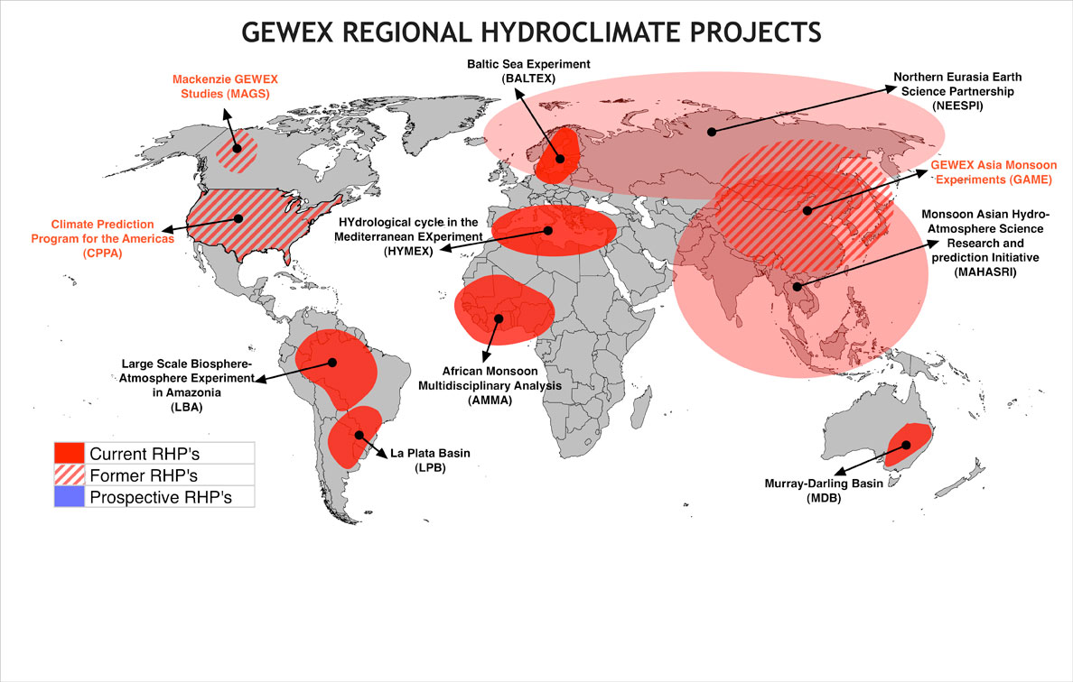
BALTEX was founded in 1992 as part of the
GEWEX programme of WCRP
www.baltic.earth

Slide 6

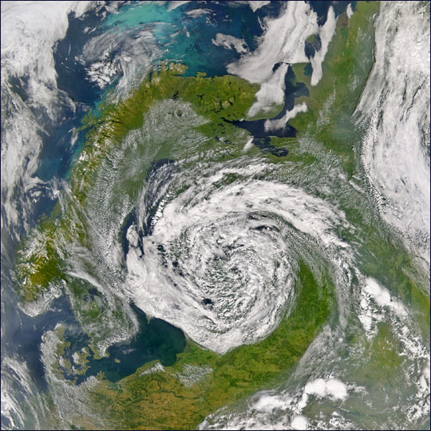
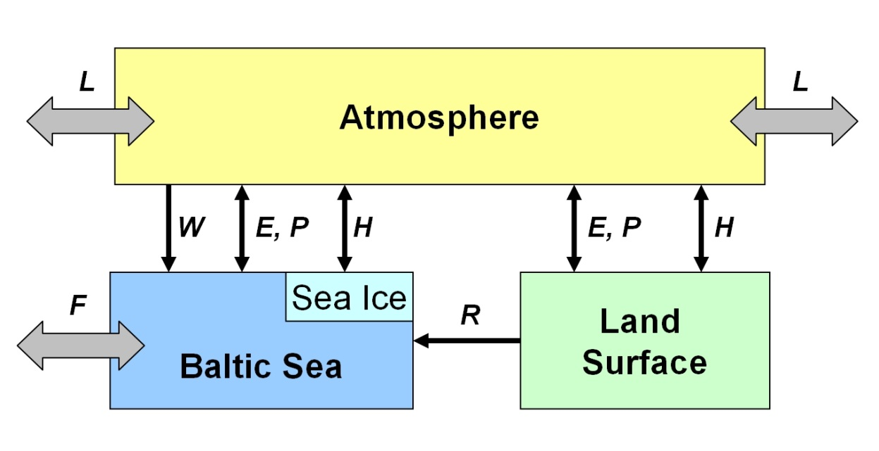
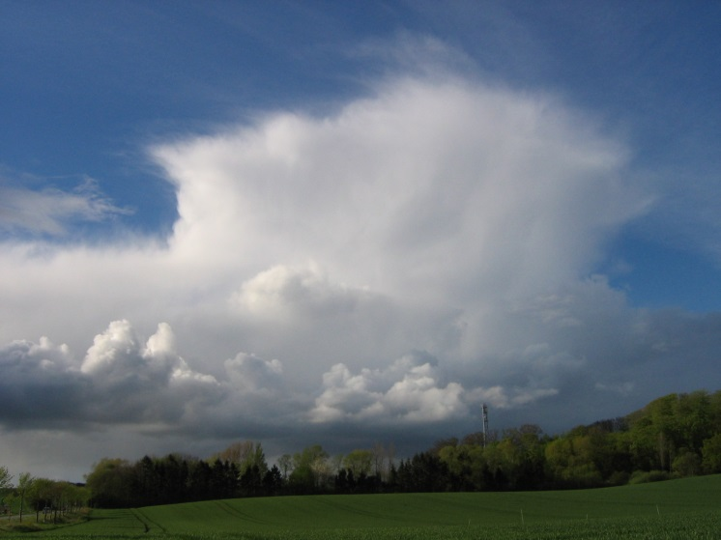
BALTEX Phase I: 1992 – 2003: First 10 year Phase
BALTEX was founded in 1992 as part of the GEWEX programme of WCRP
The hydrological cycle and the exchange of energy between the atmosphere
and the surface of the Earth (pysical part of the climate system)
Major disciplines: Meteorology, Oceanography, Hydrology
Major outcomes of BALTEX Phase I (1992-2003:
Building of research and observation network; data exchange and availability, development of coupled regional atmosphere-land-ocean models

Slide 7
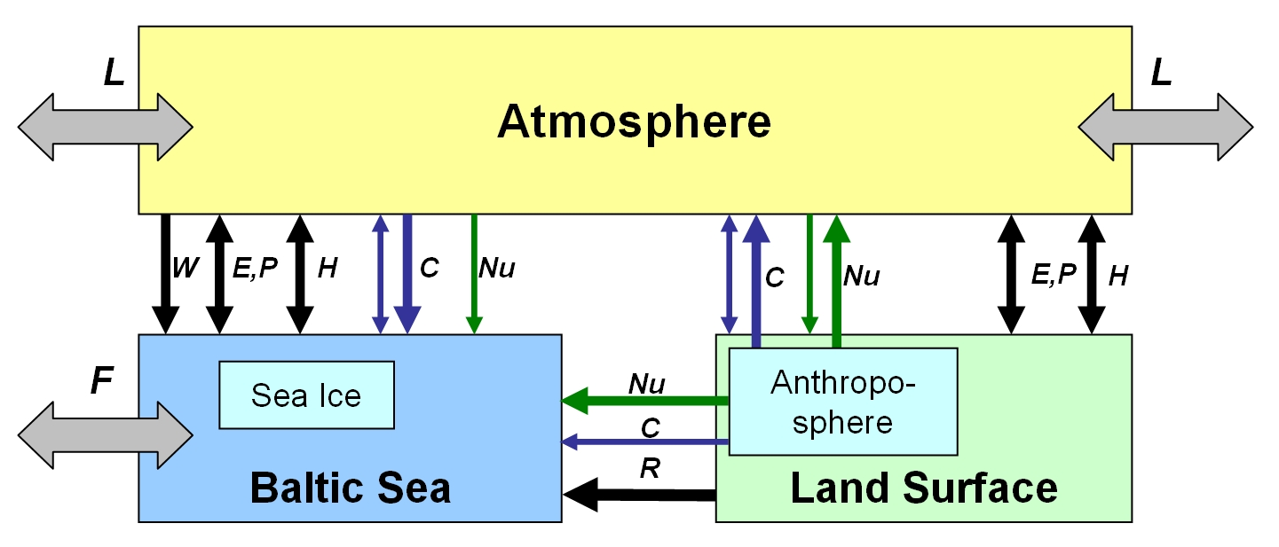
BALTEX Phase II: 2003 - 2012: Second 10 year Phase
BALTEX Phase II has evolved into an environmental research network dealing with the
Earth system of the entire Baltic Sea catchment including terrestrial and marine biogeochemical cycles
Scientific disciplines (in Phase II):
Meteorology
Hydrology
Climatology
Oceanography
Biogeochemistry
Important elements are
Climate variability and change
and related impacts on the environment and the human sphere
BALTEX Assessment of Climate Change for the Baltic Sea basin (BACC)

Slide 8
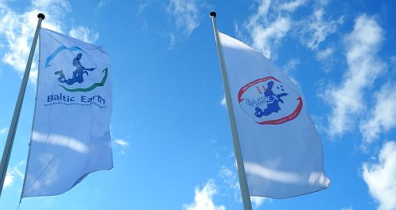
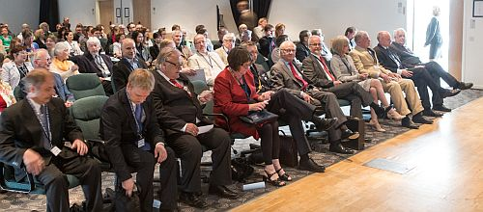
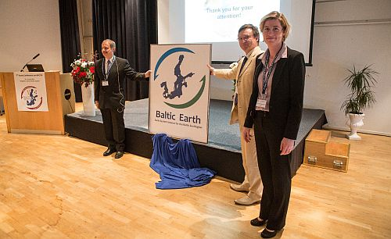
Baltic Earth – Launch in June 2013
Baltic Earth launched at the
7th Study Conference on BALTEX in June 2013
this guy…
… in the presence of the King of Sweden

Slide 9

Baltic Earth – Earth System Science for the Baltic Sea region
Vision of the new programme
To achieve an improved Earth System understanding of the Baltic Sea region
Interdisciplinary and international collaboration (conferences, workshops, etc.)
Holistic view on the Earth system of the Baltic Sea region, encompassing processes in the atmosphere, on land and in the sea and also in the anthroposphere
“Service to society” in the respect that thematic assessments provide an overview over knowledge gaps which need to be filled (e.g. by funded projects)
Education (summer schools)
Inherits the BALTEX network of scientists
and infrastructure

Slide 10
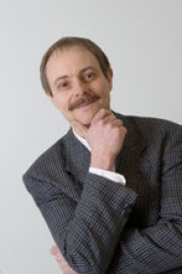
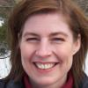
Baltic Earth – Infrastructure and Steering Group
Baltic Earth Infrastructure
Baltic Earth Science Steering Group as of June 2014
International Baltic Earth Secretariat
at Helmholtz Zentrum Geesthacht
Baltic Earth Science Steering Group (BESSG) Excellent, active “young” scientists; country balance, gender balance, discipline balance, institutional balance, currently 19 members;
meetings biannually
Working Groups installed for each GC plus
  WG on Outreach and Communication
  WG on Education
  WG on the Utility of Regional Climate Models WG on the Assessment of Scenario Simulations for the Baltic Sea 1960-2100
  Senior Advisory Board
  Science Plan
  Website, social media
  Publication series, Newsletter
  Publication database
Chair
Markus Meier, Head of Physical Oceanography, Baltic Sea Research Institute, Germany
Vice-Chair
Anna Rutgersson, Professor of Meteorology, Uppsala University, Sweden

Slide 11

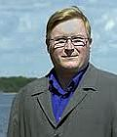
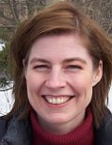
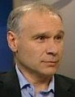

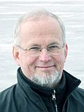
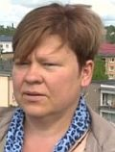
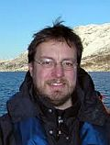
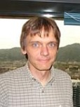
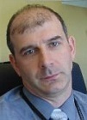

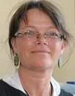



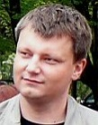





BALTEX Infrastructure and Activities
Baltic Earth SSG members
Kai Myrberg
Finland
Anna Rutgersson
Sweden
Jari Haapala
Finland
Sergey Zhuravlev
Russia
Anders Omstedt
Sweden
Piia Post
Estonia
Ben Smith
Sweden
Juris Aigars
Latvia
Martin Stendel
Denmark
Irina Partasenok
Belarus
Inga Dailidienė
Lithuania
Corinna
Schrum
Germany
Andreas
Lehmann
Germany
Markus
Meier
Germany
Karol Kulinski
Poland
Gregor Rehder
Germany
Marcus
Reckermann
Germany
Ralf
Weisse
Germany
Franz Berger
Germany

Slide 12
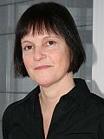
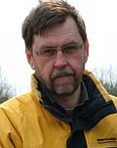
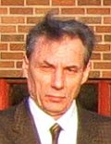
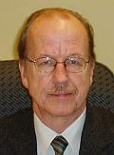
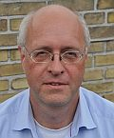

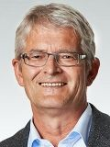
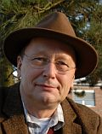
BALTEX Infrastructure and Activities
Baltic Earth
Senior Advisory Board
Ulla Li Zweifel
HELCOM
Andris Andrusailtis
BONUS
Valery Vuglinsky
Russia
Jüri Elken
Estonia
Fritz Köster
Denmark
Hans von Storch
Germany
Kay Emeis
Germany
Hans-Jörg Isemer
Germany

Slide 13
Baltic Earth – Science Plan and Grand Challenges
Current Grand Challenges
GC1: Salinity dynamics in the Baltic Sea
GC2: Land-Sea biogeochemical feedbacks in the Baltic Sea region
GC3: Natural hazards and extreme events in the Baltic Sea region
GC4: Understanding sea level dynamics in the Baltic Sea
GC5: Understanding regional variability of water and energy exchanges
GC 6: Multiple drivers of Earth system changes in the Baltic Sea region
The human impact will be assessed at all levels, wherever possible and meaningful
Website: www.baltic.earth
Baltic Earth Science Plan
and Grand Challenges
Flexible science plan with a continuously on-going definition of core research questions which are identified to be key scientific issues, so-called “Grand Challenges” (GCs)
New Grand Challenges will be identified at conferences and by using assessments of existing research by dedicated working groups. Grand Challenges are envisaged to be research foci for periods of about 3-4 years (then terminated or updated)
The new programme will communicate with stakeholders and research funding agencies to promote funding relevant for the Grand Challenges
International embedment
(GEWEX, Future Earth)

Slide 14
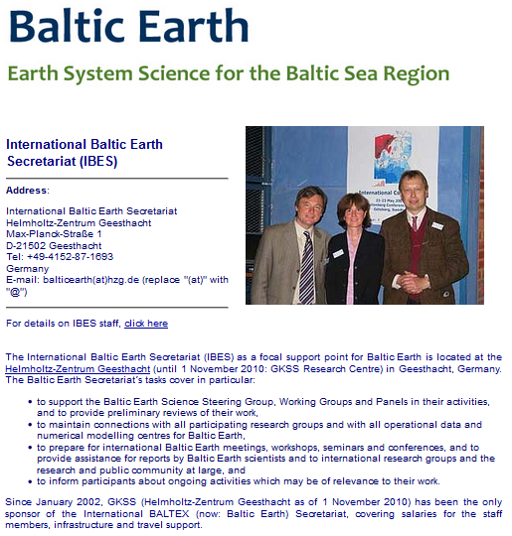

Infrastructure
Secretariat
Publications
Website etc.
Events

Slide 15
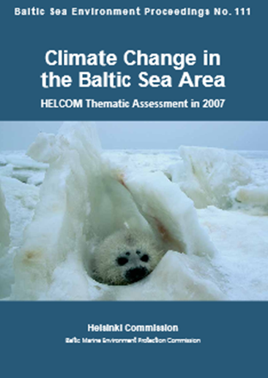
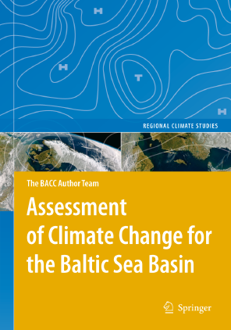
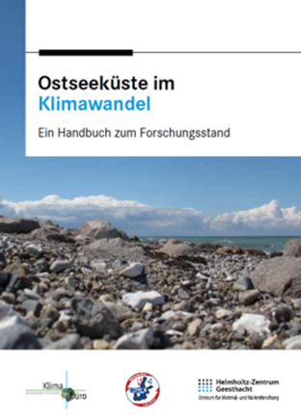
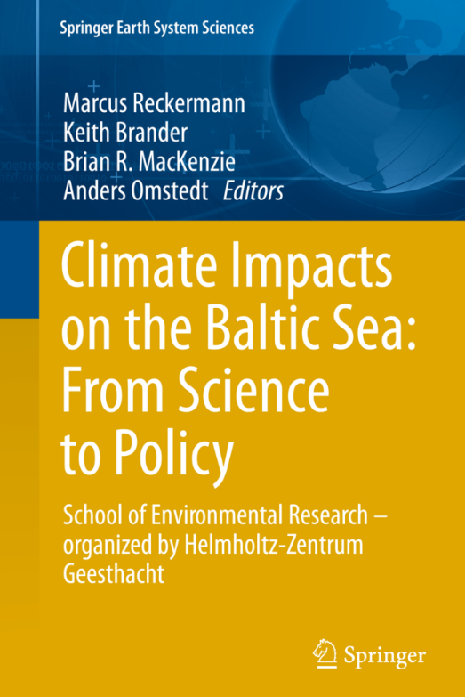
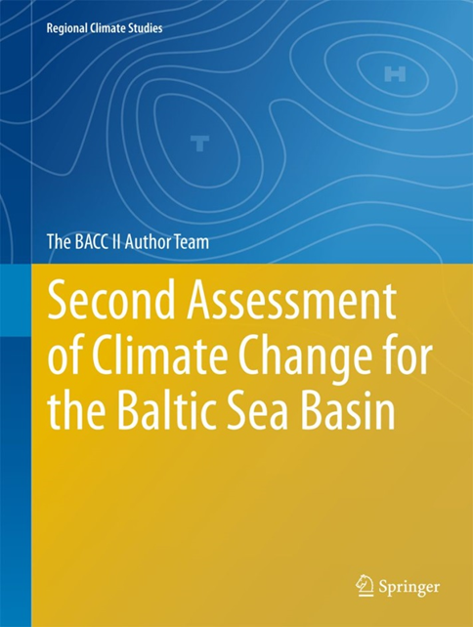
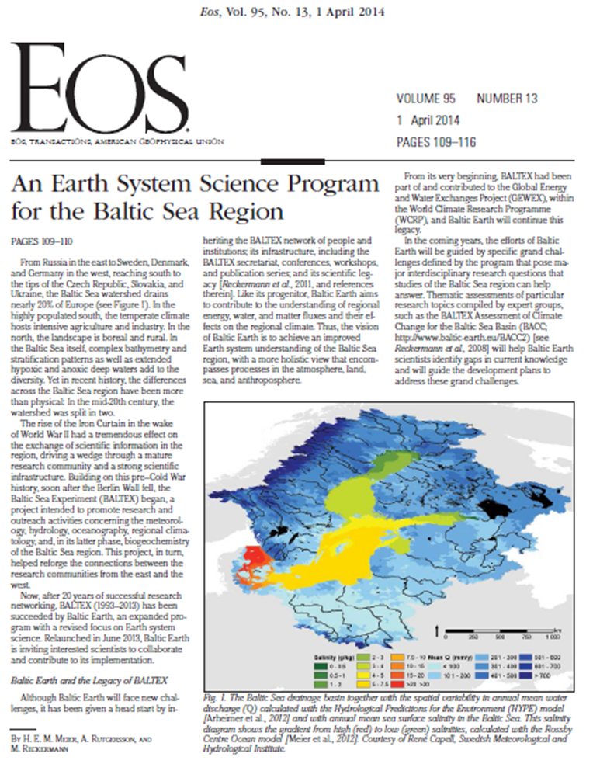
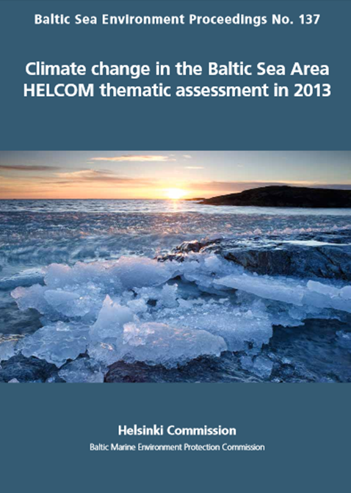
Infrastructure
Secretariat
Publications
Website etc.
Events

Slide 16
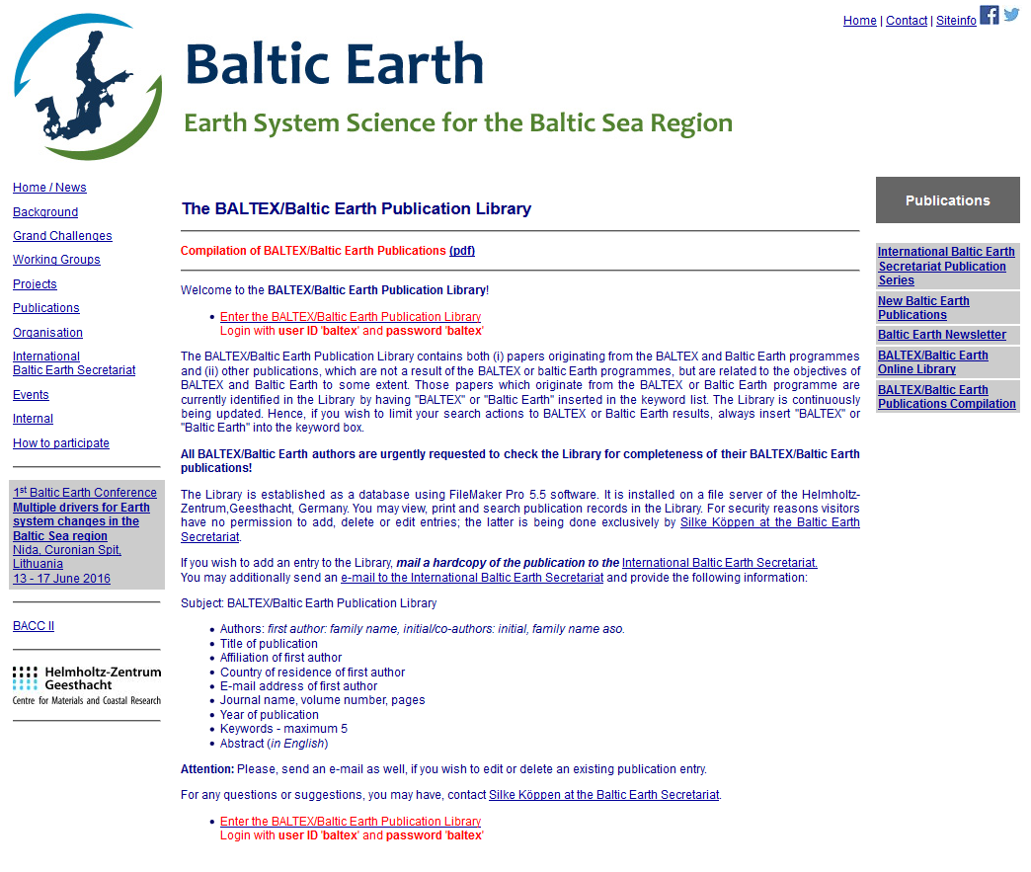
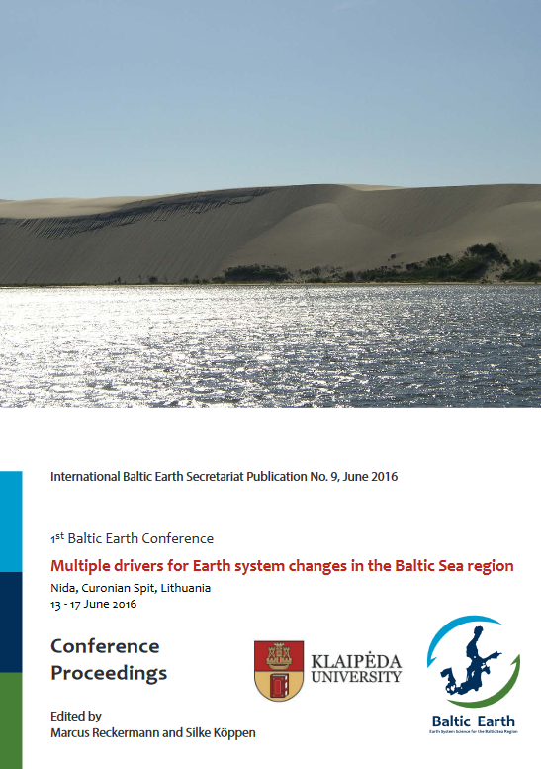
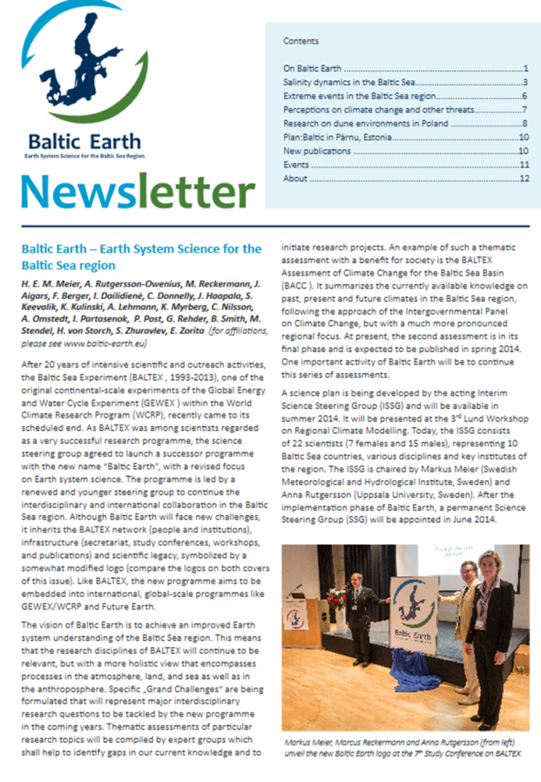
Infrastructure
International Baltic Earth Secretariat Publication Series (ISSN 2198-4247),
9 issues to date
Secretariat
Newsletter
14 books
722 peer-reviewed journal articles
65 reports
876 BALTEX/Baltic Earth Conference presentations
55 International BALTEX Secretariat Publication Series issues
9 International Baltic Earth Secretariat Publication Series issues
Publications
Website

Slide 17

Infrastructure
Secretariat
Publications
www.baltic.earth
Website etc.
Events

Slide 18



Infrastructure
Secretariat
Publications
Website etc.
Events

Slide 19
BALTEX Infrastructure and Activities
Baltic Earth Conferences
Conferences
Workshops and Seminars
Summer Schools
2nd Baltic Earth Conference
Helsingør, Denmark, June 2018
1st Baltic Earth Conference
Nida, Lithuania, June 2016
Hamburg, Germany
May 2014, Mar 2015, Sep 2016
Vienna, Austria, Apr 2015, Apr 2016 EGU
Rome, Italy, Nov 2015 HyMex

Slide 20


Events
Summer Schools
Workshops and Seminars
Topical Conferences
Baltic Earth Conferences

Slide 21


Events
Summer Schools
Workshops and Seminars
Topical Conferences
Baltic Earth Conferences

Slide 22



Events
Summer Schools
Workshops and Seminars
Topical Conferences
Baltic Earth Conferences

Slide 23


Events
Summer Schools
Workshops and Seminars
Baltic Earth-MedCORDEX Workshop on Regional Coupled Modelling
Mallorca, Spain
March 2018
Topical Conferences
Baltic Earth Conferences

Slide 24









Events
Summer Schools
Workshops and Seminars
Joint Baltic Earth-ESA Workshop on
Remote Sensing applications
in the Baltic Sea region
Helsinki, Finland
29-31 March 2017
Topical Conferences
Baltic Earth Conferences
Regularly organizing sessions at large international conferences

Slide 25


Events
Summer Schools
Workshops and Seminars
Topical Conferences
Baltic Earth Conferences

Slide 26

Events
Summer Schools
Workshops and Seminars
Topical Conferences
Baltic Earth Conferences

Slide 27


Events
Summer Schools
Workshops and Seminars
Topical Conferences
Baltic Earth Conferences

Slide 28

Baltic Earth Science Plan and Grand Challenges
Flexible science plan with a continuously on-going definition of core research questions which are identified to be key scientific issues, so-called “Grand Challenges” (GCs)
New Grand Challenges will be identified at conferences and by using assessments of existing research by dedicated working groups. Grand Challenges are envisaged to be research foci for periods of about 3-4 years (then terminated or updated).
The human impact will be assessed at all levels, wherever possible and senseful
Notes:
Vorstellung, BALTEX Secretariat, coordination of BACC project

Slide 29
Currently: 6 Grand Challenges
GC1: Salinity dynamics
GC2: Land-Sea biogeochemical linkages
GC3: Natural hazards and extreme events
GC4: Sea level and coastal dynamics of the Baltic Sea
GC5: Regional variability of water and energy exchanges
GC6: Multiple drivers of regional Earth system changes
Notes:
Vorstellung, BALTEX Secretariat, coordination of BACC project

Slide 30
GC1: Salinity dynamics in the Baltic Sea
Andreas Lehman, GEOMAR
Kai Myrberg, FMI
Piia Post, University of Tarttu
Interrelation between decadal/climate variability and salinity
Water mass exchange and major Baltic inflows
Regional salinity distribution/variability and associated circulation patterns (including salinity fluxes between the coastal areas and the open sea and within the sub‐basins)
Elken and Matthäus (2008)
Notes:
Vorstellung, BALTEX Secretariat, coordination of BACC project

Slide 31

GC2: Land-Sea biogeochemical linkages
Gergor Rehder, IOW
Karol Kulinski, IO-PAN
Benjamin Smith, Lund University
C, N, P cycles studies for the understanding primary production mechanism and organic matter transformations in the Baltic Sea
Transformations and pathways of terrestrial organic matter, influence of the terrestrial input on the carbonate system
Extension of the databases with the missing terrestrial loads data of the key chemical substances (e.g. Neva River)
Omstedt et al
Notes:
Vorstellung, BALTEX Secretariat, coordination of BACC project

Slide 32


GC3: Natural hazards and extreme events
in the Baltic Sea region
Jaari Haapala, FMI
Anna Rutgersson, Uppsala University
Martin Stendel, DMI,
Flooding at DMI
Society is very sensitive to extreme geophysical events that have severe implications for human life, generate economic losses and influence ecosystems
A natural disaster links extreme geophysical events to ecosystems and society (in particular weaknesses in ecosystems and society)
Understanding the underlying causes of natural disasters increases the ability to predict the occurrence and severity and may save human lives as well as mitigate economic losses
Photos: Martin Stendel and Finn Majlergaard
Notes:
Vorstellung, BALTEX Secretariat, coordination of BACC project

Slide 33

GC4: Sea Level and Coastal Dynamics
Ralf Weisse, HZG
Anders Omstedt University of Gothenburg
Birgit Hunicke, HZG
Future sea level changes on time scales from seasons to decades (mean and extreme sea levels)
A systematic comparison of tide-gauges and high resolution satellite products, more high-resolution ocean and atmosphere-ocean regional simulations of the Baltic Sea are becoming available
Consistent analysis of all data sets is needed
Estimations of crustal deformation rates in the Baltic Sea Region derived by different methods. From Richter et al. (2011) and Harff et al. (2010).
Notes:
Vorstellung, BALTEX Secretariat, coordination of BACC project

Slide 34

GC5: Regional variability of water and energy exchanges in the Baltic Sea region
Sergej Zhuravlev, Saint-Petersburg State University
Irina Partasenok, Centre for Hydrometeorology
Franz Berger, DWD
The observation of atmospheric processes
The diagnosis of natural variability of energy and water components
The improved description and modelling of atmospheric processes
The extended and continuous evaluation of atmospheric processes with conventional meteorological/hydrological observations
The modelling/prediction of short- and long-term water and energy exchanges
Notes:
Vorstellung, BALTEX Secretariat, coordination of BACC project

Slide 35



GC6: Multiple drivers of
regional Earth system changes
Juris Aigars, University of Latvia
Anneli Poska, Lund University
Marcus Reckermann, Helmholtz-Zentrum Geesthacht
A mixture of interwoven factors, such as regional climate change, eutrophication, pollution, fisheries, hydrographic engineering, agricultural and forestry practices and land cover change are responsible for the current situation and of potential importance as drivers of future changes.
There is a need for increased cooperation among researchers having specialised knowledge of different components of the coupled biophysical-societal system.
Key disciplines include meteorology and climate science, oceanography, hydrology, marine, terrestrial and freshwater ecology, microbiology and biogeochemistry, economists, human geographers, political scientists and engineers.
Notes:
Vorstellung, BALTEX Secretariat, coordination of BACC project

Slide 36

GC6: Multiple drivers of
regional Earth system changes
from Baltic Earth Science Plan 2017
Notes:
Vorstellung, BALTEX Secretariat, coordination of BACC project

Slide 37

Baltic Earth
Science Plan
2017
Notes:
Vorstellung, BALTEX Secretariat, coordination of BACC project

Slide 38
Baltic Earth – Earth System Science for the Baltic Sea region
Benefits and collaboration
HZG is visible as coordinating institution
in a large international and interdisciplinary network of institutions and scientists
Opportunities for international and interdisciplinary cooperation and collaboration
Information on projects and publications distributed in the Baltic Earth community
www.baltic.earth

Slide 39

Thank you for your attention!

