Slide 1


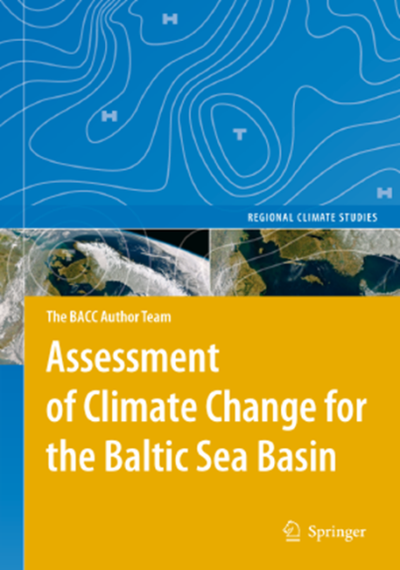
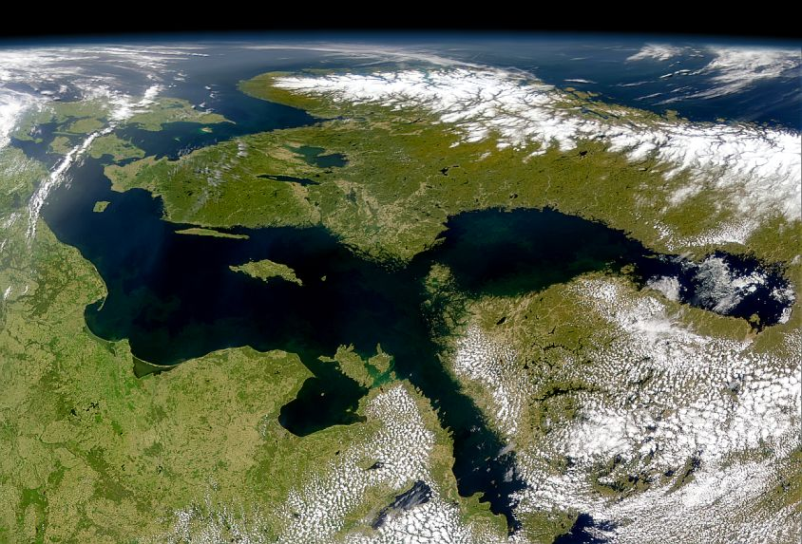
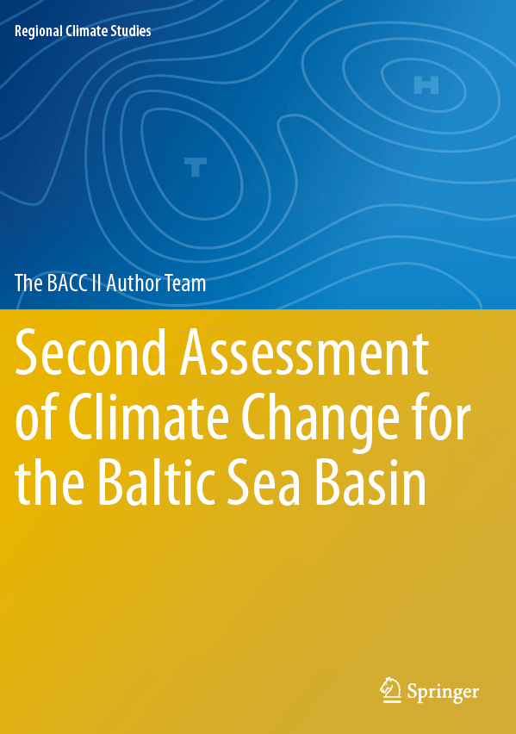
Baltic Earth
Earth System Science and Outreach
for the Baltic Sea Region
Recent developments 2016/2017
Marcus Reckermann
International Baltic Earth Secretariat
Helmholtz-Zentrum Geesthacht, Germany
Markus Meier, Anna Rutgersson
and the Baltic Earth Science Steering Group members

Slide 2
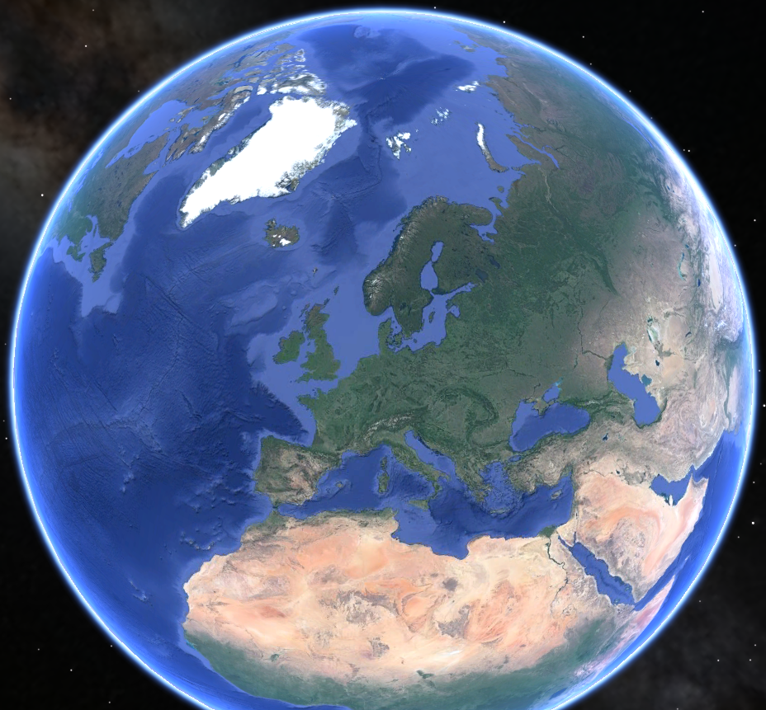

The Baltic Sea region

Slide 3
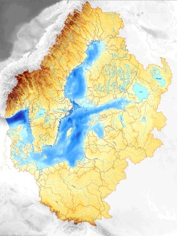
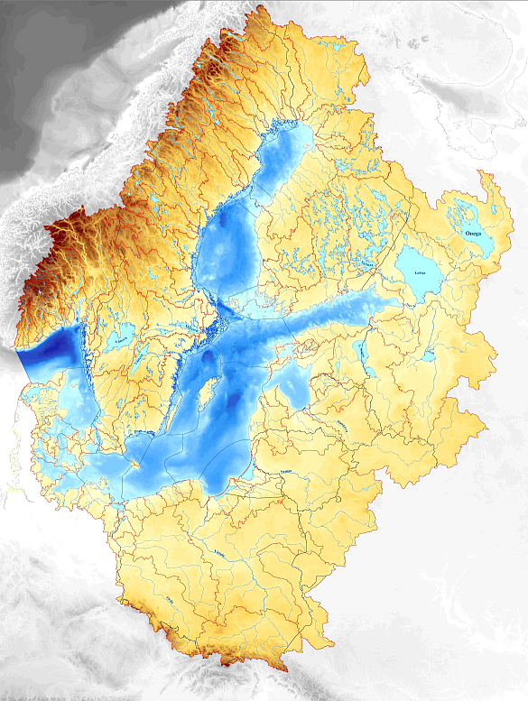
The Baltic Sea region
Drainage Basin: 2.13 Mill. km²
(20% of the European continent)
85 million people in 14 countries
Baltic Sea: 380 000 km²
St. Petersburg:
Northernmost city with > 1 million

Slide 4
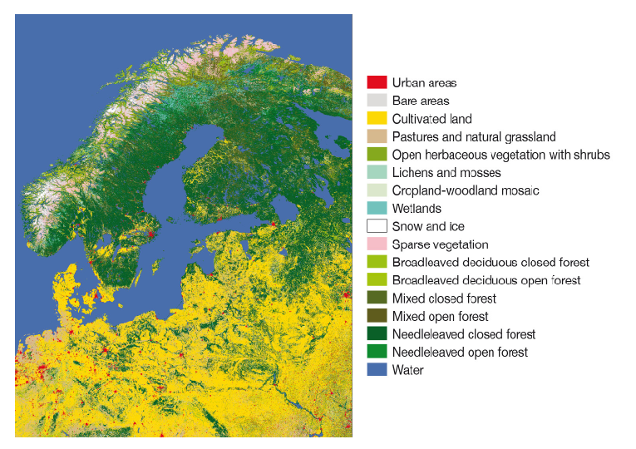
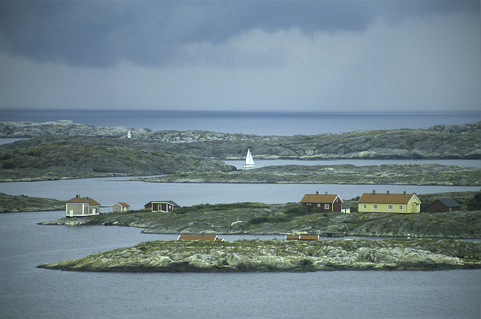
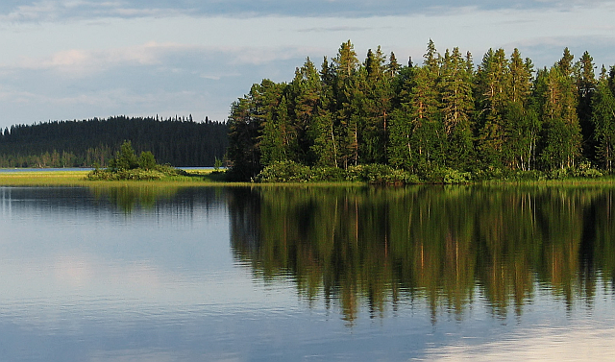
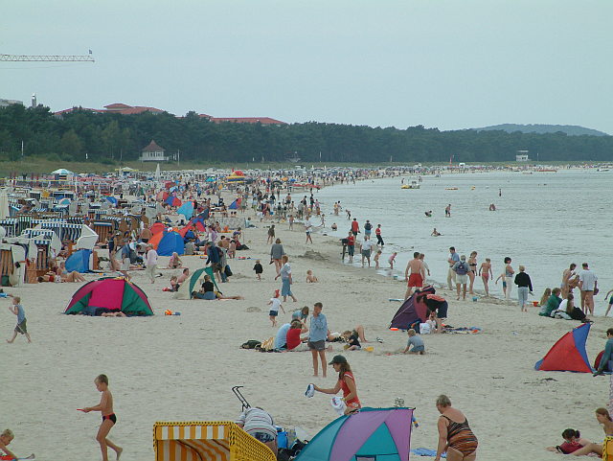
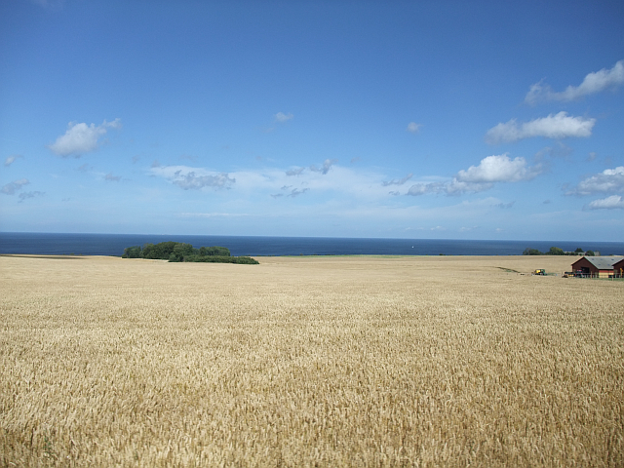
The Baltic Sea region
The North …
  extensive forests, mostly coniferous
  sparsely populated
  mostly rocky coasts
  subarctic climate in winter
  The South…
  intense agriculture
  densely populated
  mostly sandy coasts
  moderate climate in winter

Slide 5
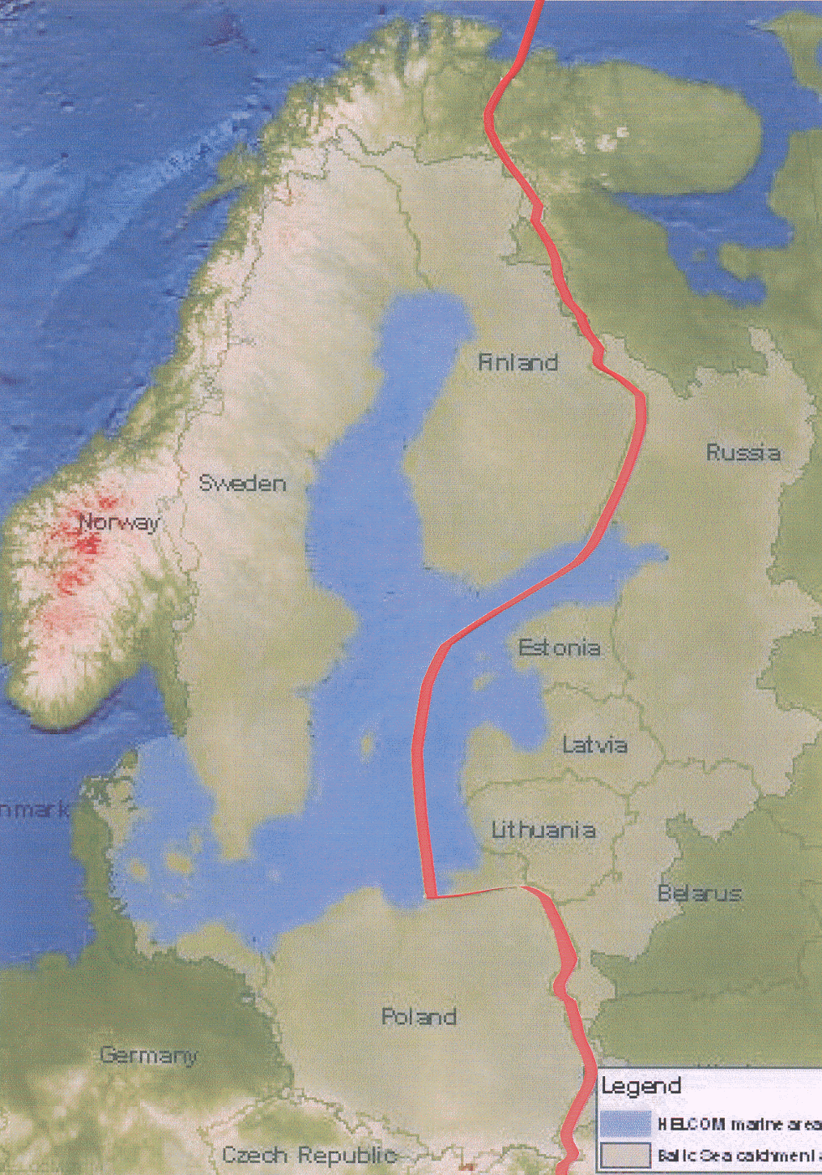
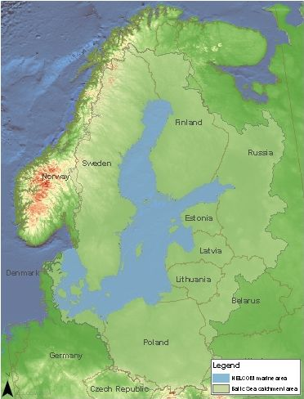
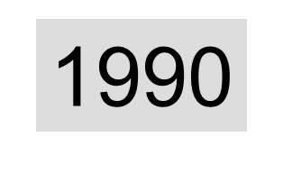
Motivation for an international interdisciplinary research network
1991
www.baltic.earth

Slide 6



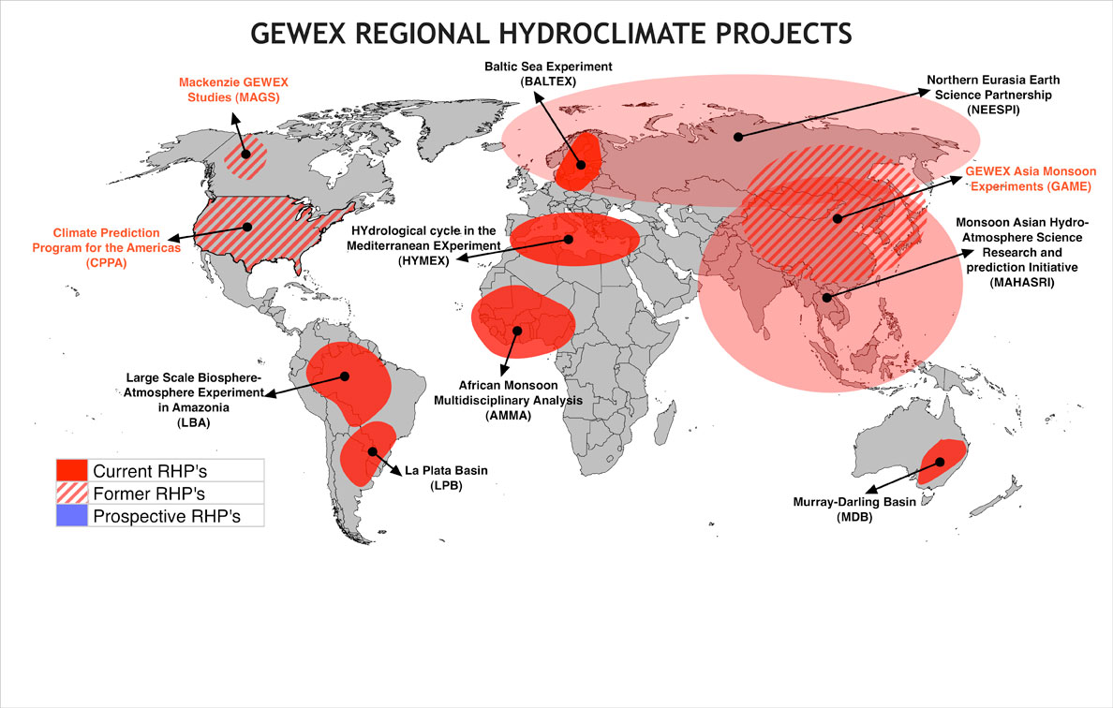
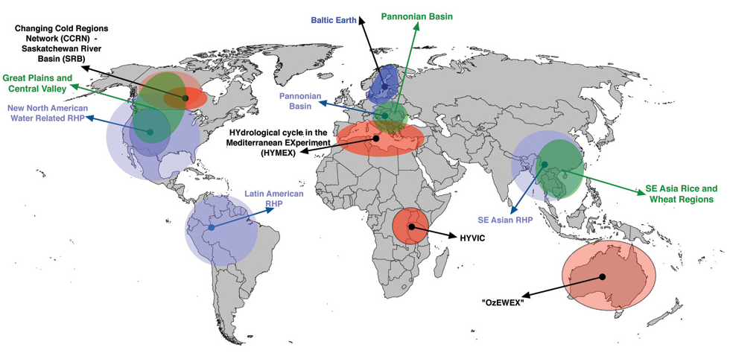
BALTEX was founded in 1992 as part of the
GEWEX programme of WCRP
www.baltic.earth

Slide 7

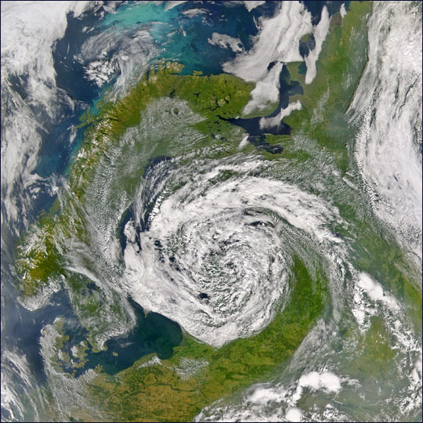
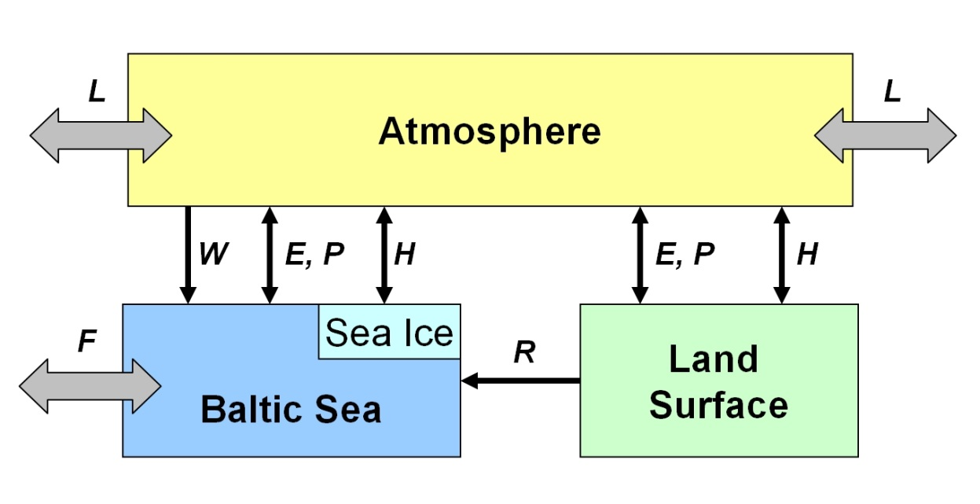
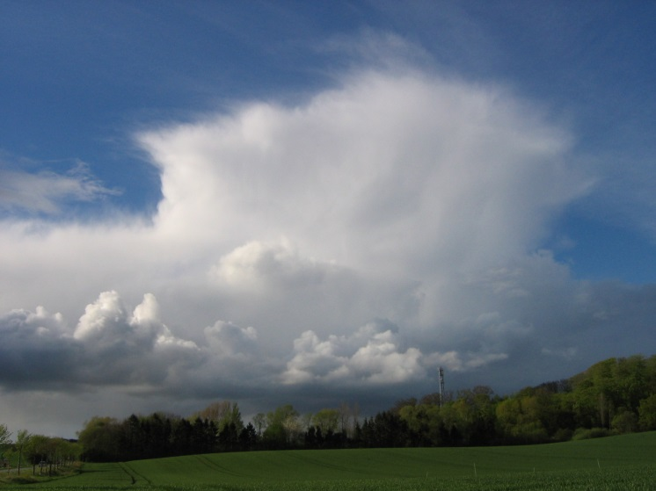
BALTEX Phase I: 1992 – 2003: First 10 year Phase
BALTEX was founded in 1992 as part of the GEWEX programme of WCRP
The hydrological cycle and the exchange of energy between the atmosphere
and the surface of the Earth (pysical part of the climate system)
Major disciplines: Meteorology, Oceanography, Hydrology
Major outcomes of BALTEX Phase I (1992-2003:
Building of research and observation network; data exchange and availability, development of coupled regional atmosphere-land-ocean models

Slide 8
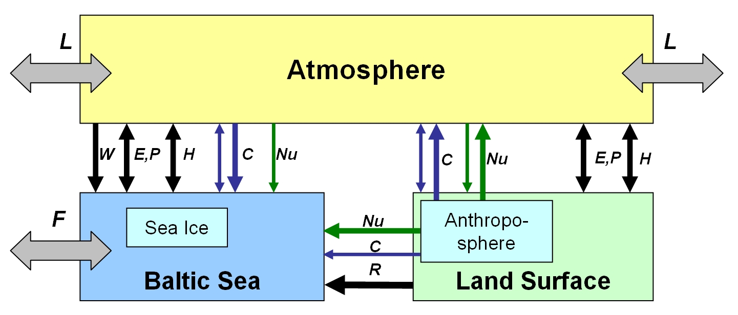
BALTEX Phase II: 2003 - 2012: Second 10 year Phase
BALTEX Phase II has evolved into an environmental research network dealing with the
Earth system of the entire Baltic Sea catchment including terrestrial and marine biogeochemical cycles
Scientific disciplines (in Phase II):
Meteorology
Hydrology
Climatology
Oceanography
Biogeochemistry
Important elements are
Climate variability and change
and related impacts on the environment and the human sphere
BALTEX Assessment of Climate Change for the Baltic Sea basin (BACC)

Slide 9
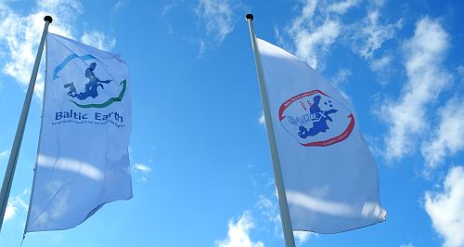
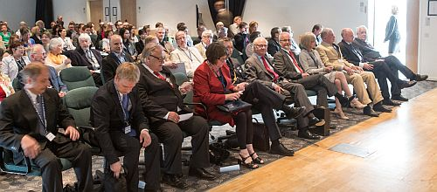
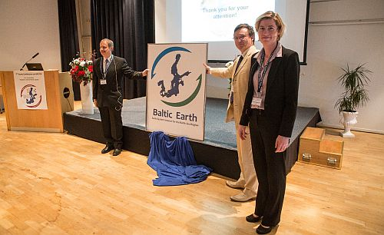
Baltic Earth – Launch in June 2013
Baltic Earth launched at the
7th Study Conference on BALTEX in June 2013
this guy…
… in the presence of the King of Sweden

Slide 10

Baltic Earth – Earth System Science for the Baltic Sea region
Vision of the new programme
To achieve an improved Earth System understanding of the Baltic Sea region
Interdisciplinary and international collaboration (conferences, workshops, etc.)
Holistic view on the Earth system of the Baltic Sea region, encompassing processes in the atmosphere, on land and in the sea and also in the anthroposphere
“Service to society” in the respect that thematic assessments provide an overview over knowledge gaps which need to be filled (e.g. by funded projects)
Education (summer schools)
Inherits the BALTEX network of scientists
and infrastructure

Slide 11
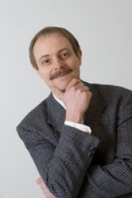
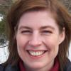
Baltic Earth – Infrastructure and Steering Group
Baltic Earth Infrastructure
Baltic Earth Science Steering Group as of June 2014
International Baltic Earth Secretariat
at Helmholtz Zentrum Geesthacht
Baltic Earth Science Steering Group (BESSG) Excellent, active “young” scientists; country balance, gender balance, discipline balance, institutional balance, currently 19 members;
meetings biannually
Working Groups installed for each GC plus
  WG on Outreach and Communication
  WG on Education
  WG on the Utility of Regional Climate Models WG on the Assessment of Scenario Simulations for the Baltic Sea 1960-2100
  Senior Advisory Board
  Science Plan
  Website, social media
  Publication series, Newsletter
  Publication database
Chair
Markus Meier, Head of Physical Oceanography, Baltic Sea Research Institute, Germany
Vice-Chair
Anna Rutgersson, Professor of Meteorology, Uppsala University, Sweden

Slide 12

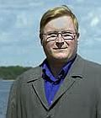
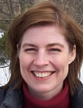
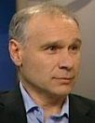

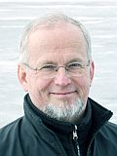
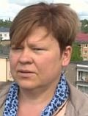
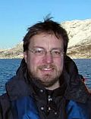
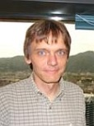
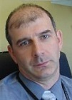

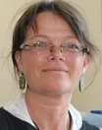



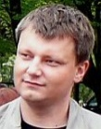





BALTEX Infrastructure and Activities
Baltic Earth SSG members
Kai Myrberg
Finland
Anna Rutgersson
Sweden
Jari Haapala
Finland
Sergey Zhuravlev
Russia
Anders Omstedt
Sweden
Piia Post
Estonia
Ben Smith
Sweden
Juris Aigars
Latvia
Martin Stendel
Denmark
Irina Partasenok
Belarus
Inga Dailidienė
Lithuania
Corinna
Schrum
Germany
Andreas
Lehmann
Germany
Markus
Meier
Germany
Karol Kulinski
Poland
Gregor Rehder
Germany
Marcus
Reckermann
Germany
Ralf
Weisse
Germany
Franz Berger
Germany

Slide 13
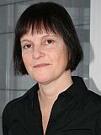
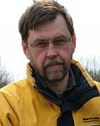
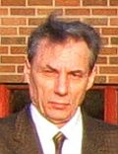
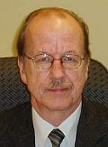
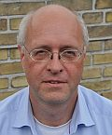

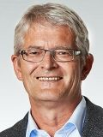
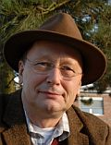
BALTEX Infrastructure and Activities
Baltic Earth
Senior Advisory Board
Ulla Li Zweifel
HELCOM
Andris Andrusailtis
BONUS
Valery Vuglinsky
Russia
Jüri Elken
Estonia
Fritz Köster
Denmark
Hans von Storch
Germany
Kay Emeis
Germany
Hans-Jörg Isemer
Germany

Slide 14
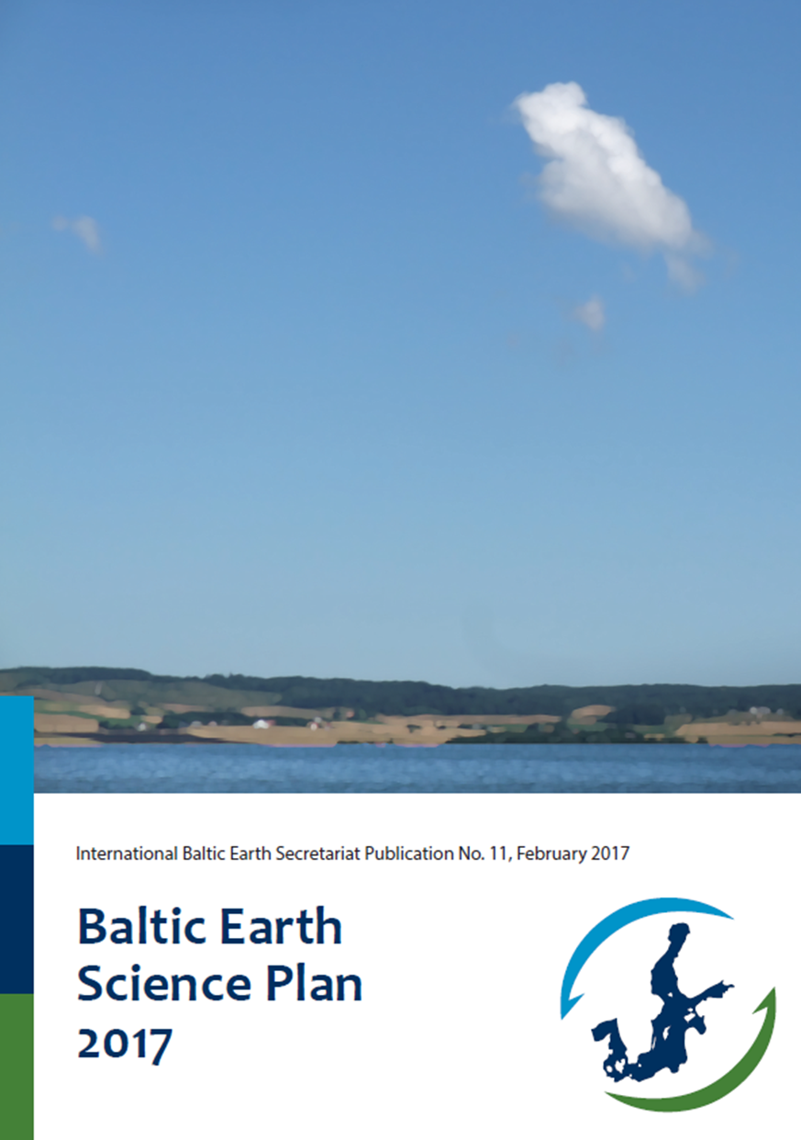
Baltic Earth – Science Plan and Grand Challenges
Current Grand Challenges
GC1: Salinity dynamics in the Baltic Sea
GC2: Land-Sea biogeochemical feedbacks in the Baltic Sea region
GC3: Natural hazards and extreme events in the Baltic Sea region
GC4: Understanding sea level dynamics in the Baltic Sea
GC5: Understanding regional variability of water and energy exchanges
GC 6: Multiple drivers of Earth system changes in the Baltic Sea region
The human impact will be assessed
at all levels, wherever possible
and meaningful
Website: www.baltic.earth
Flexible science plan with a continuously on-going definition of core research questions which are identified to be key scientific issues, so-called
“Grand Challenges” (GCs)
New Grand Challenges will be identified at conferences and by using assessments of existing research by dedicated working groups. Grand Challenges are envisaged to be research foci for periods of about 3-4 years (then terminated or updated)
The new programme will communicate with stakeholders and research funding agencies to promote funding relevant for the Grand Challenges
International embedment

Slide 15
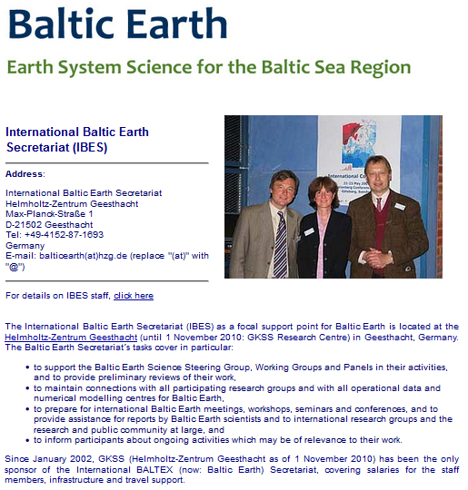

Infrastructure
Secretariat
Publications
Website etc.
Events

Slide 16
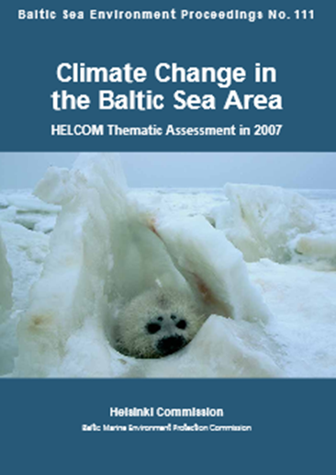
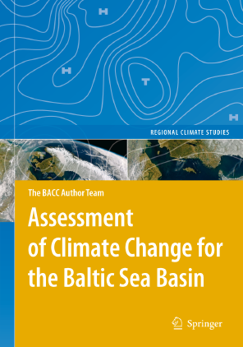
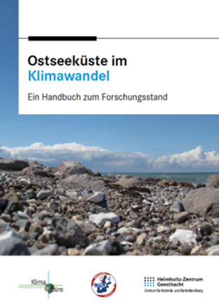
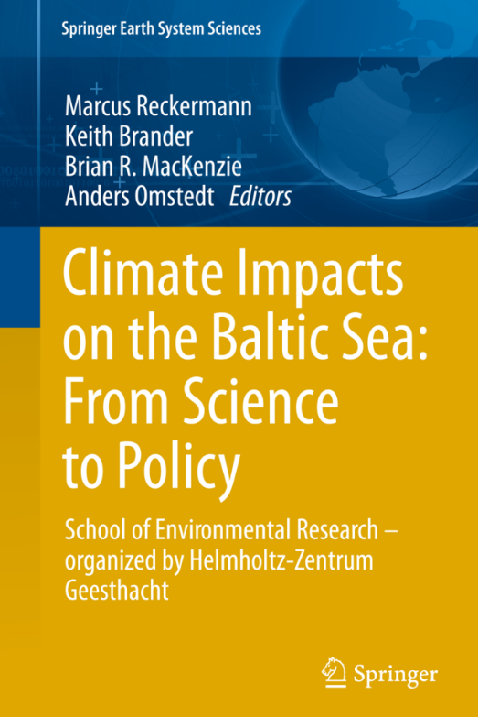
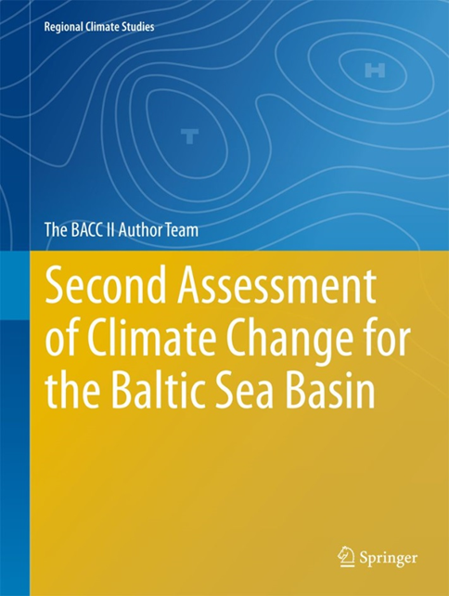
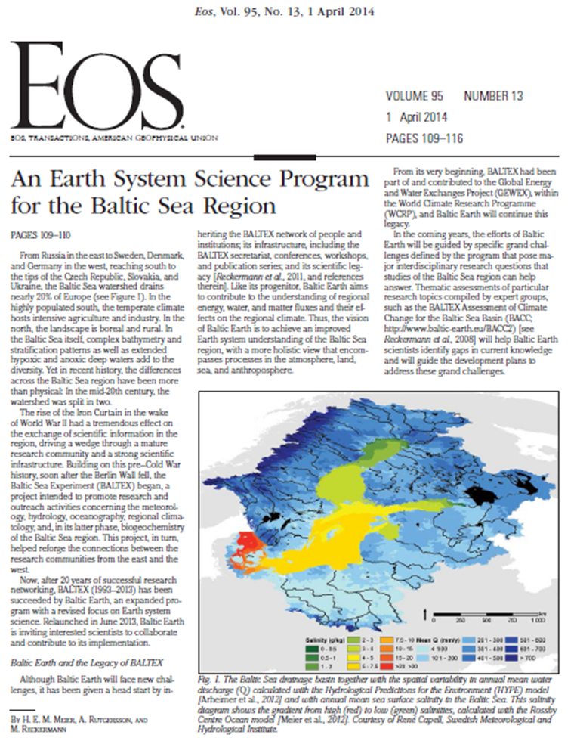

Infrastructure
Secretariat
Publications
Website etc.
Events

Slide 17



Infrastructure
International Baltic Earth Secretariat Publication Series (ISSN 2198-4247),
9 issues to date
Secretariat
Newsletter
14 books
722 peer-reviewed journal articles
65 reports
876 BALTEX/Baltic Earth Conference presentations
55 International BALTEX Secretariat Publication Series issues
9 International Baltic Earth Secretariat Publication Series issues
Publications
Website

Slide 18

Infrastructure
Secretariat
Publications
www.baltic.earth
Website etc.
Events

Slide 19





Infrastructure
Secretariat
Publications
Website etc.
Events

Slide 20
BALTEX Infrastructure and Activities
Baltic Earth Conferences
Conferences
Workshops and Seminars
Summer Schools
2nd Baltic Earth Conference
Helsingør, Denmark, June 2018
1st Baltic Earth Conference
Nida, Lithuania, June 2016
Hamburg, Germany
May 2014, Mar 2015, Sep 2016
Vienna, Austria, Apr 2015, Apr 2016 EGU
Rome, Italy, Nov 2015 HyMex

Slide 21





Events
Summer Schools
Workshops and Seminars
Topical Conferences
Baltic Earth Conferences

Slide 22



Events
Summer Schools
Workshops and Seminars
Topical Conferences
Baltic Earth Conferences

Slide 23


Events
Summer Schools
Workshops and Seminars
Baltic Earth-MedCORDEX Workshop on Regional Coupled Modelling
Mallorca, Spain
March 2018
Topical Conferences
Baltic Earth Conferences

Slide 24









Events
Summer Schools
Workshops and Seminars
Joint Baltic Earth-ESA Workshop on
Remote Sensing applications
in the Baltic Sea region
Helsinki, Finland
29-31 March 2017
Topical Conferences
Baltic Earth Conferences
Regularly organizing sessions at large international conferences

Slide 25


Events
Summer Schools
Workshops and Seminars
Topical Conferences
Baltic Earth Conferences

Slide 26

Events
Summer Schools
Workshops and Seminars
Topical Conferences
Baltic Earth Conferences

Slide 27


Events
Summer Schools
Workshops and Seminars
Topical Conferences
Baltic Earth Conferences

Slide 28

Baltic Earth Science Plan and Grand Challenges
Flexible science plan with a continuously on-going definition of core research questions which are identified to be key scientific issues, so-called “Grand Challenges” (GCs)
New Grand Challenges will be identified at conferences and by using assessments of existing research by dedicated working groups. Grand Challenges are envisaged to be research foci for periods of about 3-4 years (then terminated or updated).
The human impact will be assessed at all levels, wherever possible and senseful
Notes:
Vorstellung, BALTEX Secretariat, coordination of BACC project

Slide 29

Baltic Earth
Science Plan
2017
Notes:
Vorstellung, BALTEX Secretariat, coordination of BACC project

Slide 30
Currently: 6 Grand Challenges
GC1: Salinity dynamics
GC2: Land-Sea biogeochemical linkages
GC3: Natural hazards and extreme events
GC4: Sea level and coastal dynamics of the Baltic Sea
GC5: Regional variability of water and energy exchanges
GC6: Multiple drivers of regional Earth system changes
Notes:
Vorstellung, BALTEX Secretariat, coordination of BACC project

Slide 31
GC1: Salinity dynamics in the Baltic Sea
Andreas Lehman, GEOMAR
Kai Myrberg, FMI
Piia Post, University of Tarttu
Interrelation between decadal/climate variability and salinity
Water mass exchange and major Baltic inflows
Regional salinity distribution/variability and associated circulation patterns (including salinity fluxes between the coastal areas and the open sea and within the sub‐basins)
Elken and Matthäus (2008)
Notes:
Vorstellung, BALTEX Secretariat, coordination of BACC project

Slide 32

GC2: Land-Sea biogeochemical linkages
Gergor Rehder, IOW
Karol Kulinski, IO-PAN
Benjamin Smith, Lund University
C, N, P cycles studies for the understanding primary production mechanism and organic matter transformations in the Baltic Sea
Transformations and pathways of terrestrial organic matter, influence of the terrestrial input on the carbonate system
Extension of the databases with the missing terrestrial loads data of the key chemical substances (e.g. Neva River)
Omstedt et al
Notes:
Vorstellung, BALTEX Secretariat, coordination of BACC project

Slide 33


GC3: Natural hazards and extreme events
in the Baltic Sea region
Jaari Haapala, FMI
Anna Rutgersson, Uppsala University
Martin Stendel, DMI,
Flooding at DMI
Society is very sensitive to extreme geophysical events that have severe implications for human life, generate economic losses and influence ecosystems
A natural disaster links extreme geophysical events to ecosystems and society (in particular weaknesses in ecosystems and society)
Understanding the underlying causes of natural disasters increases the ability to predict the occurrence and severity and may save human lives as well as mitigate economic losses
Photos: Martin Stendel and Finn Majlergaard
Notes:
Vorstellung, BALTEX Secretariat, coordination of BACC project

Slide 34

GC4: Sea Level and Coastal Dynamics
Ralf Weisse, HZG
Anders Omstedt University of Gothenburg
Birgit Hunicke, HZG
Future sea level changes on time scales from seasons to decades (mean and extreme sea levels)
A systematic comparison of tide-gauges and high resolution satellite products, more high-resolution ocean and atmosphere-ocean regional simulations of the Baltic Sea are becoming available
Consistent analysis of all data sets is needed
Estimations of crustal deformation rates in the Baltic Sea Region derived by different methods. From Richter et al. (2011) and Harff et al. (2010).
Notes:
Vorstellung, BALTEX Secretariat, coordination of BACC project

Slide 35

GC5: Regional variability of water and energy exchanges in the Baltic Sea region
Sergej Zhuravlev, Saint-Petersburg State University
Irina Partasenok, Centre for Hydrometeorology
Franz Berger, DWD
The observation of atmospheric processes
The diagnosis of natural variability of energy and water components
The improved description and modelling of atmospheric processes
The extended and continuous evaluation of atmospheric processes with conventional meteorological/hydrological observations
The modelling/prediction of short- and long-term water and energy exchanges
Notes:
Vorstellung, BALTEX Secretariat, coordination of BACC project

Slide 36



GC6: Multiple drivers of
regional Earth system changes
Juris Aigars, University of Latvia
Anneli Poska, Lund University
Marcus Reckermann, Helmholtz-Zentrum Geesthacht
A mixture of interwoven factors, such as regional climate change, eutrophication, pollution, fisheries, hydrographic engineering, agricultural and forestry practices and land cover change are responsible for the current situation and of potential importance as drivers of future changes.
There is a need for increased cooperation among researchers having specialised knowledge of different components of the coupled biophysical-societal system.
Key disciplines include meteorology and climate science, oceanography, hydrology, marine, terrestrial and freshwater ecology, microbiology and biogeochemistry, economists, human geographers, political scientists and engineers.
Notes:
Vorstellung, BALTEX Secretariat, coordination of BACC project

Slide 37

GC6: Multiple drivers of
regional Earth system changes
from Baltic Earth Science Plan 2017
Notes:
Vorstellung, BALTEX Secretariat, coordination of BACC project

Slide 38

WG on Regional Climate System Modelling
Earth system science treat the Earth as an integrated system and seeks a deeper understanding of the physical, chemical, biological and human interactions that determine the past, current and future state of the Earth
Notes:
Vorstellung, BALTEX Secretariat, coordination of BACC project

Slide 39

WG on Regional Climate System Modelling
Added value of Regional Atmosphere Models
Orographic details
Land-sea mask
Sea surface boundary conditions (SST and sea ice)
More detailed vegetation and soil characteristics
Extremes, e.g. polar lows, typhoons
SMHI’s regional climate models:
RCAO (Source: Döscher et al., 2002)
RCA-NEMO (Source: Wang et al., 2015)
Notes:
Vorstellung, BALTEX Secretariat, coordination of BACC project

Slide 40

WG on Regional Climate System Modelling
Additional components
sea ice
waves
marine biogeochemistry
(marine food web)
sediments
land surface and hydrology
lakes
(dynamic land vegetation)
(atmospheric chemistry)
Notes:
Vorstellung, BALTEX Secretariat, coordination of BACC project

Slide 41

WG on Regional Climate System Modelling
Data source: Peter Löwe, Bundesamt fuer Seeschifffahrt und Hydrographie
http://www.bsh.de/en/Marine_data/Observations/Sea_surface_temperatures/
(Source: Gröger et al., 2015)
Notes:
Vorstellung, BALTEX Secretariat, coordination of BACC project

Slide 42



WG on Regional Climate System Modelling
Advanced modeling tool for scenarios of the Baltic Sea ECOsystem to SUPPORT decision making (Meier et al. 2011, GRL)
Notes:
Vorstellung, BALTEX Secretariat, coordination of BACC project

Slide 43

WG on Regional Climate System Modelling
Difference:
Coupled
minus
Uncoupled
Ice Albedo Effect
(Source: Gröger et al., 2015)
Notes:
Vorstellung, BALTEX Secretariat, coordination of BACC project

Slide 44

Recent accomplishments (current year)
20 submitted
14 published or accepted
4 currently under review
2 rejected
(as of 10 October 2017)
https://www.earth-syst-dynam.net/special_issue861.html
Notes:
Vorstellung, BALTEX Secretariat, coordination of BACC project

Slide 45

Recent accomplishments (current year)
Special Project on
Climate and regional change
in the Baltic Sea region
Overview articles reflecting the state of science for an interdisciplinary professional readership, authored by experts in the field
Envisaged for this project:
̴ 40 articles
First just now published
̴ 10 in preparation and review
For many authorship pending
http://climatescience.oxfordre.com
Notes:
Vorstellung, BALTEX Secretariat, coordination of BACC project

Slide 46
Recent accomplishments (current year)
13-17 June 2016: 1st Baltic Earth Conference “Multiple drivers for Earth system changes in the Baltic Sea region” in Nida, Lithuania, June 2016
29 August – 5 September 2016: International Baltic Earth Summer School on Climate change in the Baltic Sea region, Askö Laboratory, Trosa, Sweden
12–16 September 2016: Session on "Evaluation and quality assurance of climate services – Methods, criteria and pitfalls" at 16th EMS Annual Meeting & 11th European Conference on Applied Climatology (ECAC), 12–16 September 2016, Trieste, Italy
21 September 2016: Baltic Earth Seminar on " Exchanges between the North and Baltic Seas – A scientific overview" in the framework of the Fehmarn Belt Days 2016, Hamburg HafenCity University, Germany
11-12 October 2016: 15th Polish-German Seminar on Coastal Research, Maritime Museum, Hamburg, Germany
22-24 November 2016: Baltic Earth Working Group meeting on Scenario Simulations Leibnitz Institute for Baltic Sea Research, Warnemünde, Germany
7-8 February 2017: Baltic Earth Workshop on "Coupled atmosphere-ocean modeling for the Baltic Sea and North Sea", Leibniz Institute for Baltic Sea Research Warnemünde (IOW), Germany
8-10 March 2017: 8th Baltic Earth Science Steering Group meeting, Leibniz Institute for Baltic Sea Research Warnemünde (IOW), Germany.
9 March 2017: Baltic Earth Seminar on "Major Baltic Inflows" connected to the 8th Baltic Earth Science Steering Group meeting, Leibniz Institute for Baltic Sea Research Warnemünde (IOW), Germany
29-31 March 2017: Baltic from Space: Joint ESA-Baltic Earth Workshop on remote sensing applications in the Baltic Sea region, Helsinki, Finland
23-28 April 2017: EGU General Assembly 2017, Vienna, Austria: Baltic Earth Session on Climate change and its impacts in the Baltic and North Sea regions: Observations and model projections, based on the work of the recently published regional BACC II (Baltic Sea region) and NOSCCA (North Sea region) climate change reports
28 August – 4 September 2017: International Baltic Earth Summer School on Climate change in the Baltic Sea region, Askö Laboratory, Trosa, Sweden
Notes:
Vorstellung, BALTEX Secretariat, coordination of BACC project

Slide 47






Recent accomplishments (current year)
BONUS INTEGRAL
Integrated carboN and TracE Gas monitoRing for the bALtic sea
Using ICOS and similar infrastructure for an improved environmental monitoring of the Baltic Sea
Notes:
Vorstellung, BALTEX Secretariat, coordination of BACC project

Slide 48


Recent accomplishments (current year)
BONUS INTEGRAL
Integrated carboN and TracE Gas monitoRing for the bALtic sea
Use of the (extended) ICOS network for biogeochemical monitoring of the Baltic Sea, in combination to existing monitoring programs
Improved ASE-parameterizations for the Baltic Sea
Provide best experimentally based seasonal concentration charts for carbon dioxide, methane, and nitrous oxide
Full integration of carbon system into high resolution physical biogeochemical model
Advice for countries with upcoming ICOS infrastructure
Model-ouput based recommendations on effective biogeochemical monitoring
Funded as a BONUS Blue Baltic project, starting date
July 1st, 2017, 3 years
Budget 2.1 Mio €
8 Partners from 5 countries
Including three current Baltic ICOS stations
Notes:
Vorstellung, BALTEX Secretariat, coordination of BACC project

Slide 49

Examples from current research
Baltic Earth GC 5: Regional variability of water and energy exchanges in the Baltic Sea region
GEWEX GSQ1: Observations and Predictions of Precipitation
Ho-Hagemann HTM, Gröger M, Rockel B, Zahn M, Geyer B, Meier HEM, 2017. Effects of air-sea coupling over the North Sea and the Baltic Sea on simulated summer precipitation over Central Europe. Climate Dynamics 48:1-26, March 2017
A coupling of atmosphere and ocean can improve the dry biases for different regional climate models but not always; but particularly for summer heavy precipitation over central Europe
Daily precipitation differences (mm/day) between the coupled and uncoupled CCLM (top row) and RCA4 (bottom row) for summer (JJA) for the period 1986–2009. The left column shows the difference in heavy precipitation (exceeds the 90th percentile). White colour denotes missing values. The right column shows only the differences that are significant at the 95% confidence level (tested with a 2-sided t test).
Notes:
Vorstellung, BALTEX Secretariat, coordination of BACC project

Slide 50

Examples from current research
Baltic Earth GC 4: Sea Level and Coastal Dynamics in the Baltic Sea region
WCRP Grand Challenges: Regional Sea-Level Change and coastal impacts
Hünicke B, Zorita E 2016: Statistical Analysis of the Accerleration of Baltic Mean Sea Level Rise, 1900-2012 Front. Mar. Sci., 22, July 2016
Globally, sea level is expected to accelerate
An acceleration for the Baltic Sea was tested statistically since 1900
Acceleration was found to be mostly positive but very low and statistically not significant
Absolute values due to acceleration would only add some cm to the expected rise of up to 1m at 2100
Acceleration of the annual mean sea-level in the Baltic Sea tide-gauges estimated in the period 1900–2012 in wintertime (A) and summertime (B) by the method gtols (see paper)
Notes:
Vorstellung, BALTEX Secretariat, coordination of BACC project

Slide 51

Planned activities (next year)
The aim of this workshop is to share recent progress in the understanding of regional climate variability with special focus on coupled effects between sea, atmosphere, land and anthroposphere.
In this workshop, we will focus on European seas and their catchment areas like the Mediterranean Sea, Black Sea, North Sea, Baltic Sea and Arctic Ocean - highly sensitive areas where global models fail to give reliable information about changing climate because key processes are not properly resolved.
Contributions related to any aspect of the description and modelling of regional climate are welcome. Some of the topics addressed in the workshop will be the description of present and future regional climates, the
development and evaluation of regional climate system models and the assessment of extreme and high impact events.
Website and Call for papers in preparation
Abstract Deadline: 12 January 2018
Notifications of authors: 22 January 2018
Registration Deadline: 26 February 2018
Notes:
Vorstellung, BALTEX Secretariat, coordination of BACC project

Slide 52


Planned activities (next year)
www.baltic.earth/helsingor2018
2nd Announcement November 2017
Abstract Submission February 2018
Registration and Hotel Reservations April 2018
Notes:
Vorstellung, BALTEX Secretariat, coordination of BACC project

Slide 53




Planned activities (next year)
4th Baltic Earth Summer School on Climate change in the Baltic Sea region
Askö, Sweden; Aug-Sept 2018
Notes:
Vorstellung, BALTEX Secretariat, coordination of BACC project

Slide 54

Planned activities (next year)
Baltic Earth Workshop on Multiple drivers of regional Earth system changes
Second half of 2018
Notes:
Vorstellung, BALTEX Secretariat, coordination of BACC project

Slide 55



Planned activities (next year)
Climate change overview booklets for non-scientists, laypeople, general public
2015
2017
2018
Dk
S
Fi
Ru
Est
Lv
Lt
Bel
Pl
D
Original report
Open Access Book
Print and free online
English
Summary for paypeople (English base version)
Paper brochure for free distribution
Free online
English
Summary for paypeople in diff. languages
General summary (translation of English base version) plus country specific details
Paper brochure for free distribution
Produced in country by responsible institution
Free online
All languages of the Baltic Sea region
Notes:
Vorstellung, BALTEX Secretariat, coordination of BACC project

Slide 56

Thank you and have a great meeting!

